Slide 1
Capstone Project - II
SUPERVISED LEARNING - CLASSIFICATION
Cardiovascular Risk Prediction
Submitted By :
Mayur Chougule

Slide 2

Contents
Overview
Data Description
Data Understanding
Data Cleaning
Data Wrangling
Exploratory Data Analysis (EDA)
Feature Engineering & Data Pre-processing
Model Implementation
Model Validation
Model Comparison
Summary & Conclusions

Slide 3

Overview
The dataset is from an ongoing caradiovascular study on residents of town of Framingham, Massacheutts.
The classification goal is to predict whether the patient has a 10 year risk of future Coronary Heart Disease (CHD) .
The dataset provides the patients information. It includes over 4000 records and has 17 attributes. Each attribute is a potential risk factor .
There are both demographic, behavioral and medical risk factors.

Slide 4
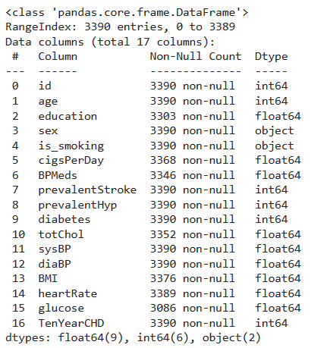

Data Description
Features mentioned in the dataset :
Sex : Gender
Age : age
Is_smoking : Whether smoking currently or not
Cigs_Per_Day : Cigarettes smoked per day
BP_Meds : Whether taking BP meds or not
Prevalent Stroke : If the patient has a history of stroke
Prevalent hyp : If the patient has a history of hypertension
Diabetes : Patient has diabetes or not
Tot Chol : Cholestrol measure
Sys BP : Systolic BP measure
Dia BP : Diastolic BP measure
BMI : Body Mass Index
Hear Rate : Heart rate measure
The dataset contains following informations of patients medical history which will help in further processing of data

Slide 5
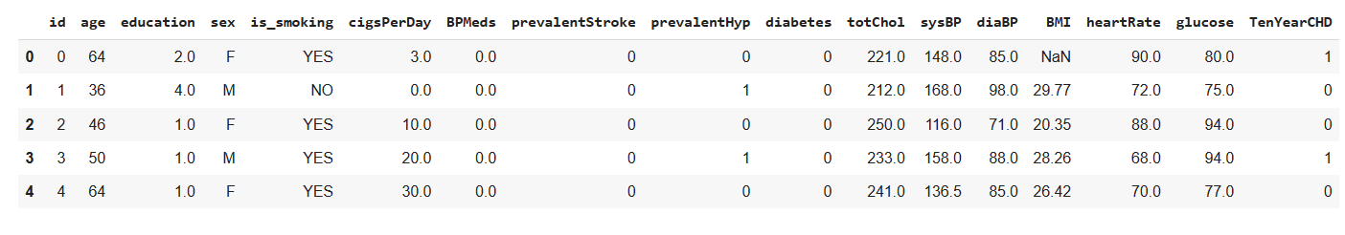

Data Understanding
How data can be used for further processing ?
Most of the data is of float data-type , also some features are already encoded into categories
Some features are linked to each other and their relationship can be used for better understanding of patient’s medical condition
From the variables description , it was seen that the dataset contains information of people aged greater than 32 and mostly is focued on older people in the age group of 45 and above and it is mostly female centric

Slide 6

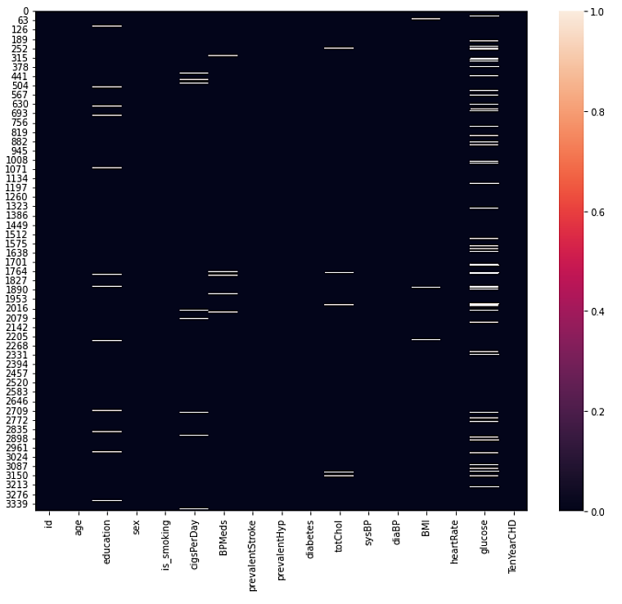
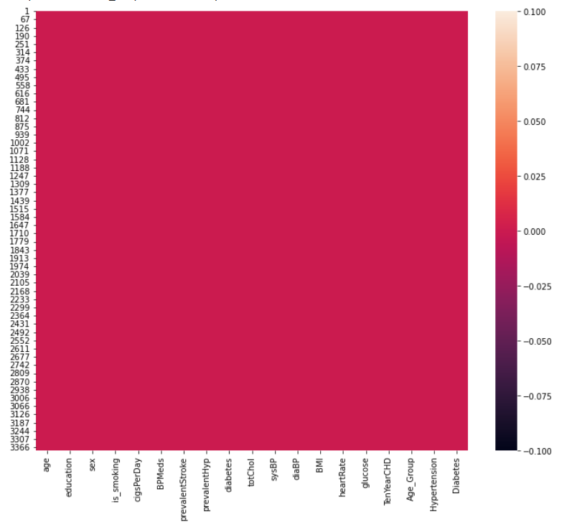
Data Cleaning
Handling Missing Values

Slide 7
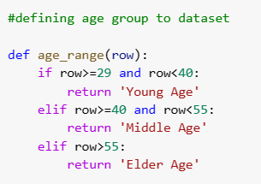
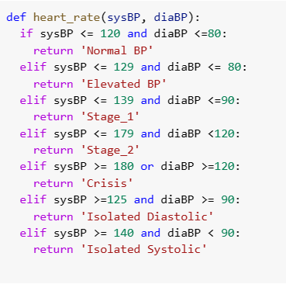
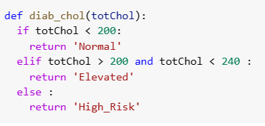
Data Wrangling
Age Group Classification
Blood Pressure Classification
Cholestrol Level Classification

Slide 8
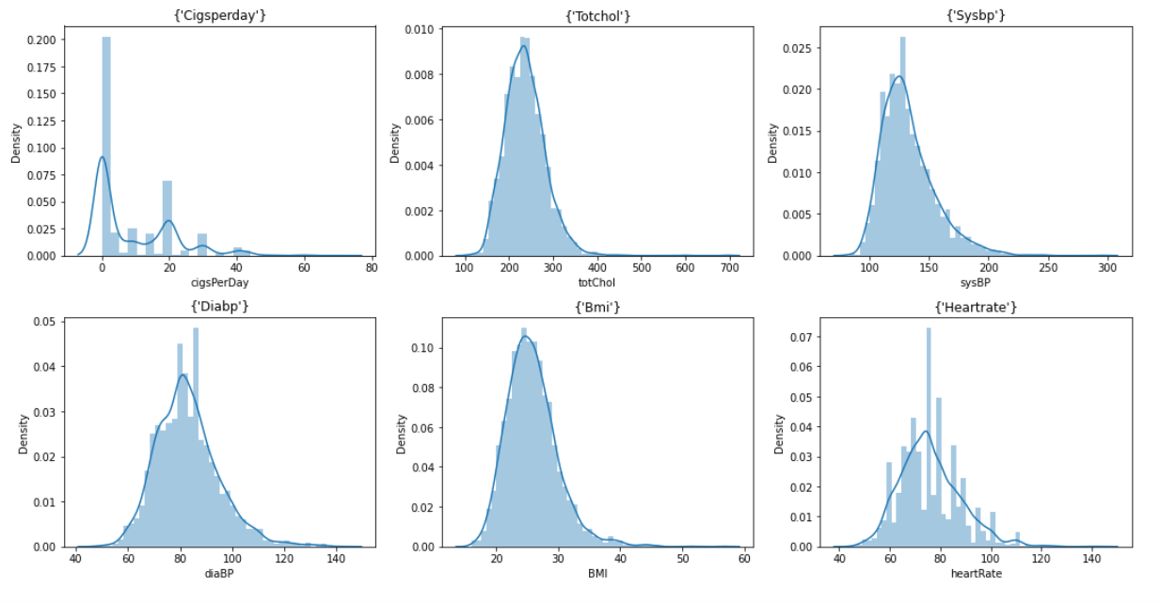
EDA
Skewness of data

Slide 9
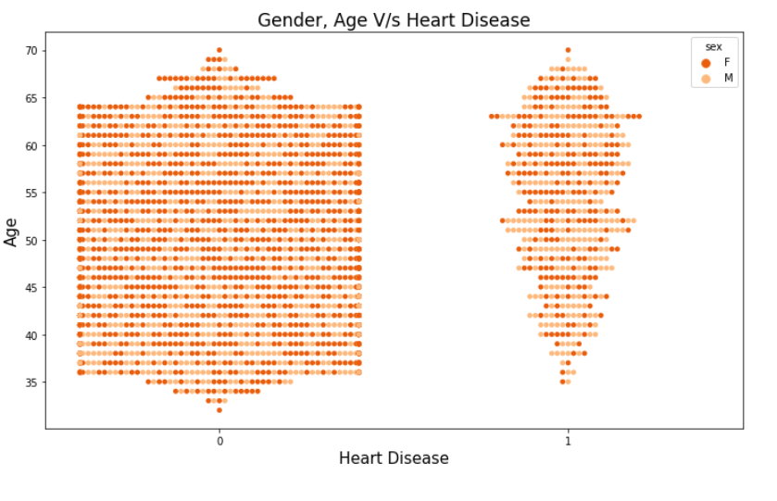
EDA
Which age group should be concerned ?
The Elder_Age group has the highest risk of heart disease than the others out of it males are at a
greater risk than females

Slide 10
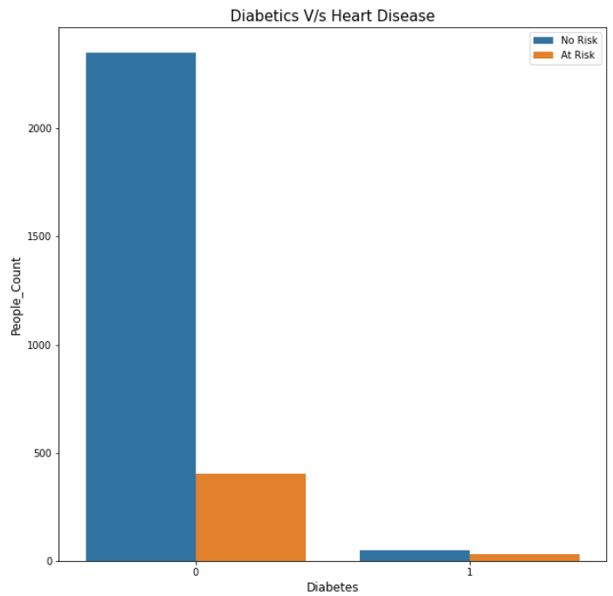
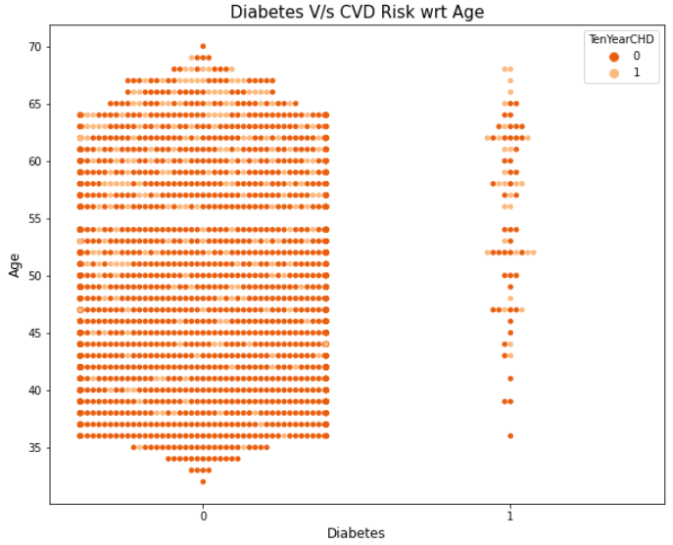
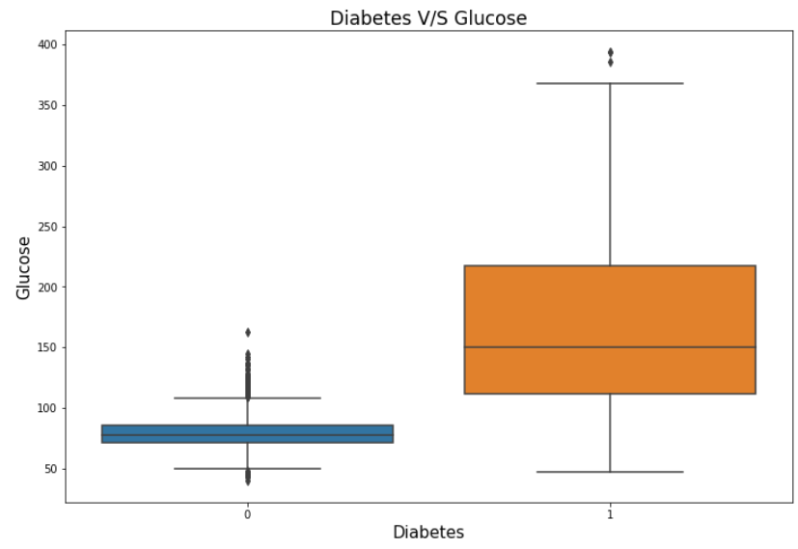
EDA
Does Diabetes increase risk of CHD ?
Very less no. of population have diabetes & it can be seen that non-diabetic patient , don’t possess a risk of CHD
Elder_people possess risk of CHD

Slide 11
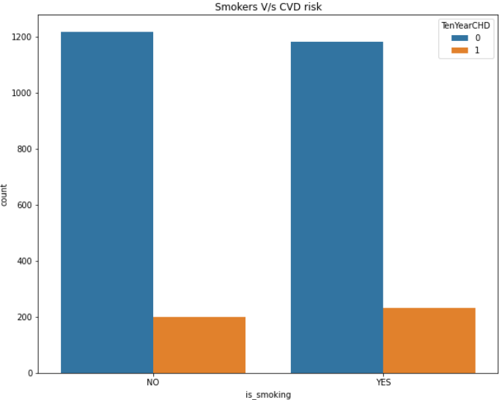
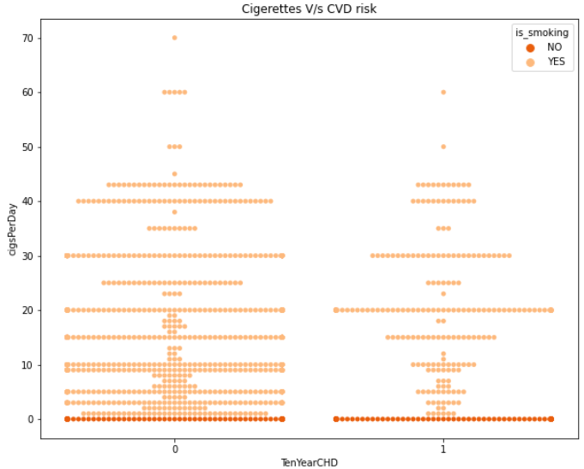
EDA
Is Smoking linked with CHD ?
No correlation between smoking and CHD risk
While people who are smoking , definitely possess the risk of CHD, a considerable amount of non-smokers also possess risk of CHD.
Hence, smoking should not be associated with CHD directly, other factors should also be considered before final conclusion.

Slide 12
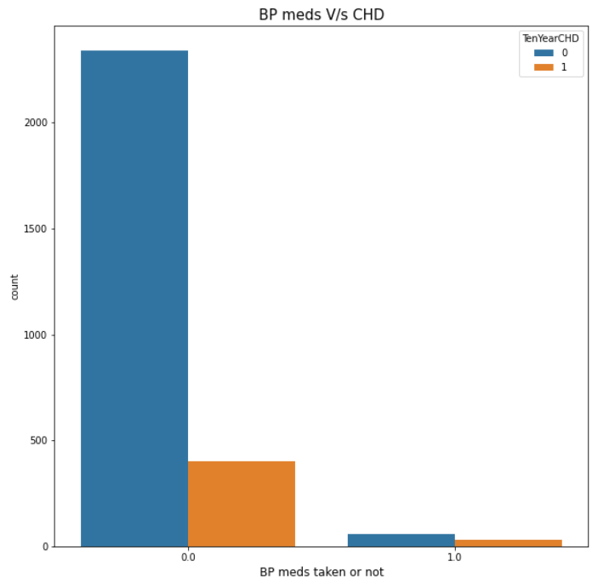
EDA
Blood Pressure relation with CHD
While patients who don’t take BP medicines , surely have no risk of CHD
Patients taking BP meds should not be concerned with CHD immediately.
For patients who consume BP medicines other factors like systolic and diastolic BP is checked

Slide 13
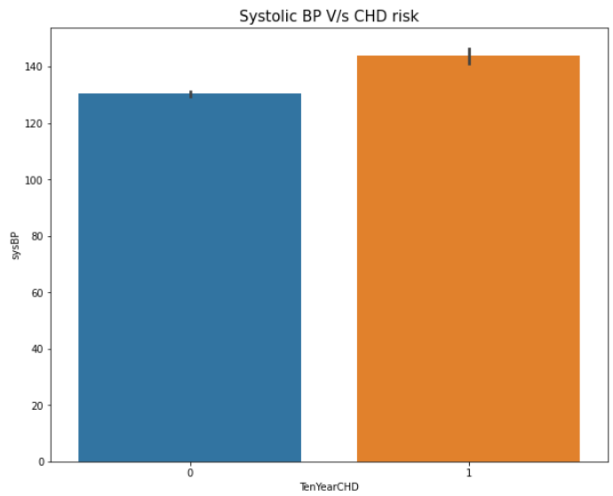
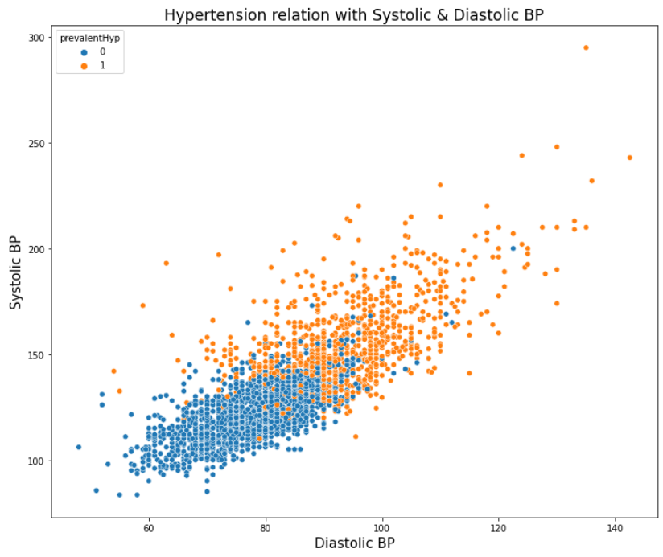
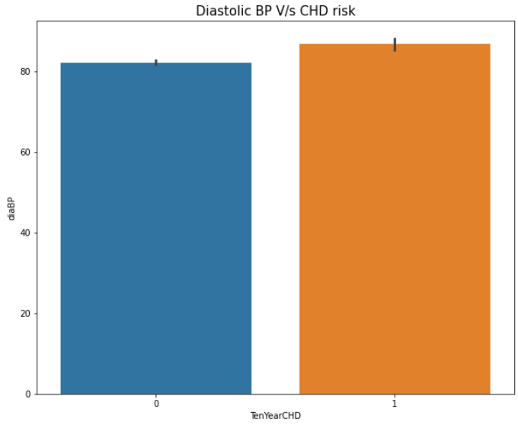
EDA
Patients with Systolic BP > 140 mm Hg and Diastolic BP > 90 mmHg possess a high risk of CHD

Slide 14
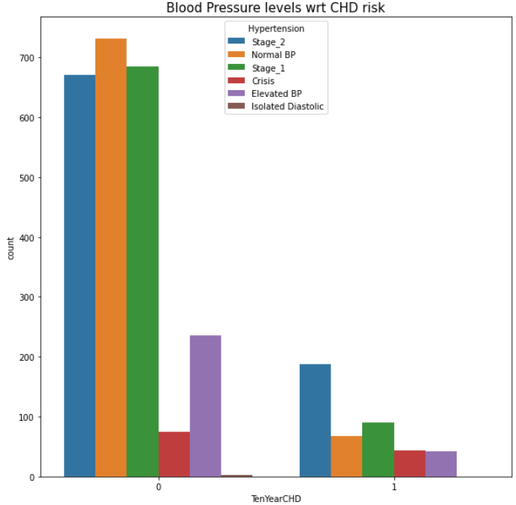
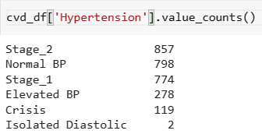
EDA
Dataset contains significant amount of patients needing immediate medical attention.

Slide 15
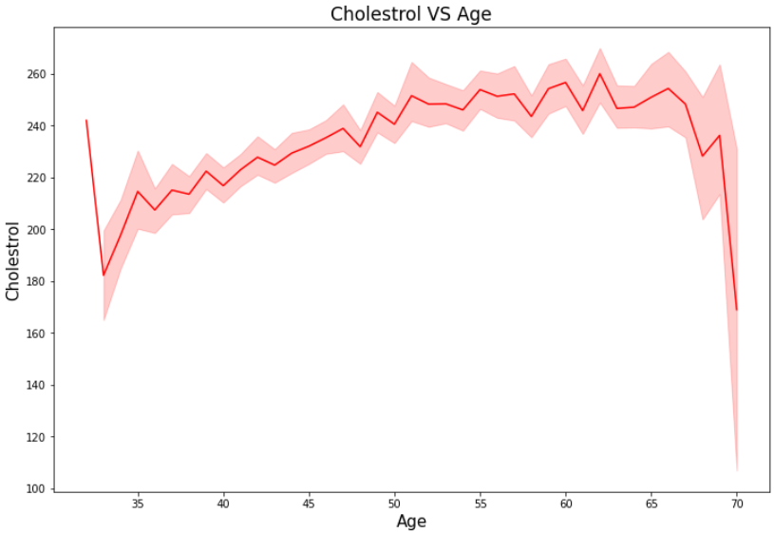
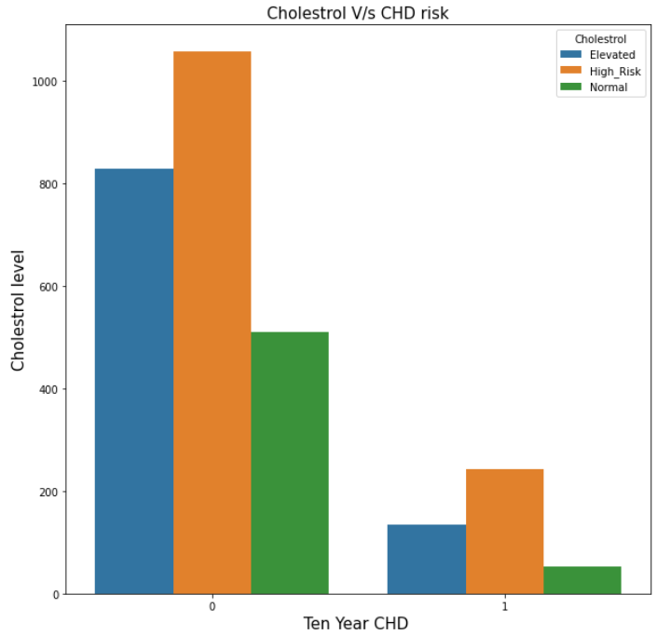

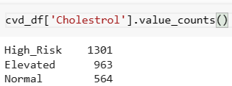
EDA
Should patient be worried about their Cholestrol level ?

Slide 16
EDA Summary
Elder patients above the 55 years should be advised to focus on mantaining a healthy life-style
Patients should be advised to avoid Cigerettes consumption, even though the EDA proves differrent.
Patients taking BP medicines should be treated thoroughly.
Heart rate, Blood Pressure are the important factors for determining whether a patient is at a risk of CHD or not
Patients with high Cholestrol level should be advised to bring a change in their daily lifestyle .

Slide 17
Outliers Treatment
IQR method of identifying outliers is used to set up a “fence” outside of Q1 and Q3. Any values that fall outside of this fence are considered outliers.
To build this fence we take 1.5 times the IQR and then subtract this value from Q1 and add this value to Q3. This gives us the minimum and maximum fence posts that we compare each observation to.
Any observations that are more than 1.5 IQR below Q1 or more than 1.5 IQR above Q3 are considered outliers.

Slide 18
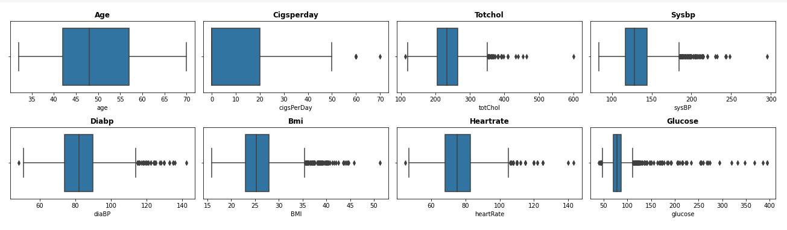
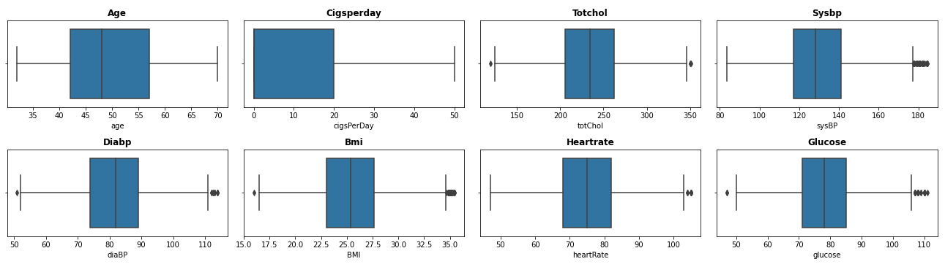
Outliers Treatment
Before
After

Slide 19
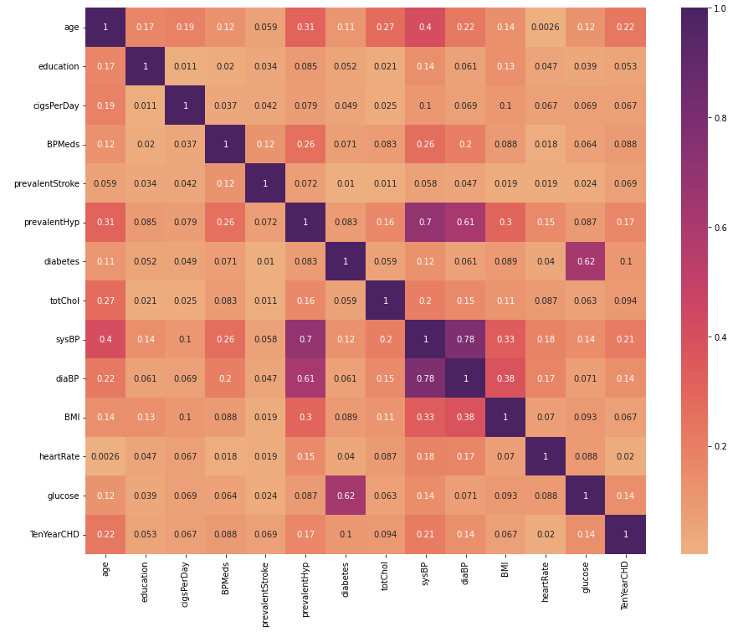
Checking Multicollinearity
Some features like sysBP ,diaBP & prevalentHyp are highly correlated, mainly due to same measures or usage and their link with CHD.

Slide 20
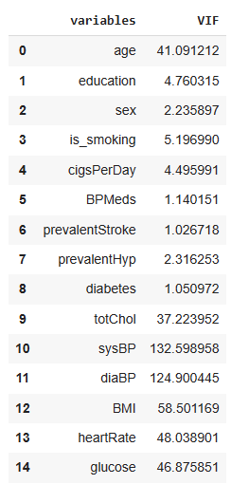
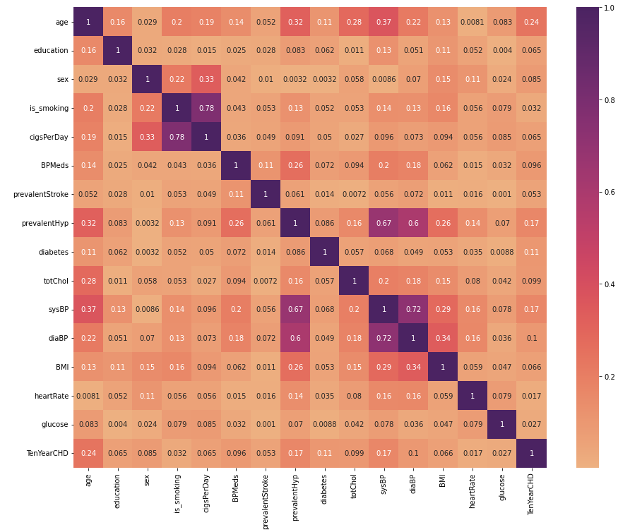
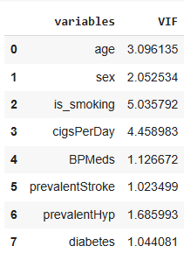
Handling Multicollinearity
To handle multicollinearity , VIF score of all independent variables is calculated , which explains how well a variable is explained by other independent variables.

Slide 21


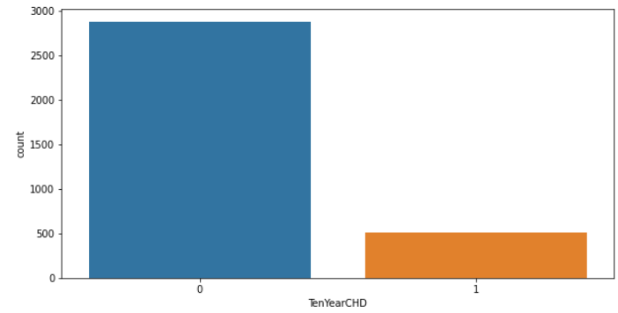
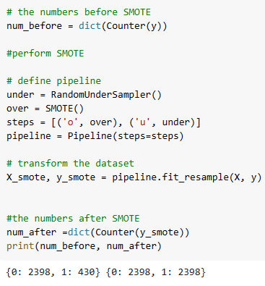
Handling Imbalanced Dataset
SMOTE Analysis :
Dataset is highly imbalanced, Synthetic Minority Oversampling Technique (SMOTE) analysis is used for handling imbalance.
SMOTE is an oversampling technique that generates synthetic samples from minority class.
It works by randomly picking a point from the minority class and computing the k-Nearest neighbors for this point.
The synthetic points are added between the chosen point and its neighbors.

Slide 22
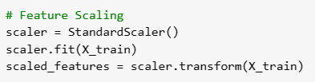
Model Pre-requisite
Feature Scaling is done to normalize the range of independent variables in a fixed range.
Standard Scaler method is used since our data is mostly normally distributed.
Standardization mantains useful information about outliers and makes algorithm less sensitive to them
Define X and y variables , splitting the data in 70-30 ratio as train and test sets.
The reason for chosing the specific ratio is , since the dataset deals with medical conditions . Hence proper training is required for the models before evaluting them on a new data.

Slide 23
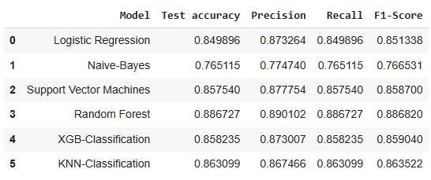
Model Implementation
Classification Models
Models were evaluated on the basis of Confusion Matrix, Precision , Recall ,F1-score, AUC-ROC curve and test accuracy.
Random-Forest provided the best result pn the basis of F1-score and Test accuracy of 89 %

Slide 24

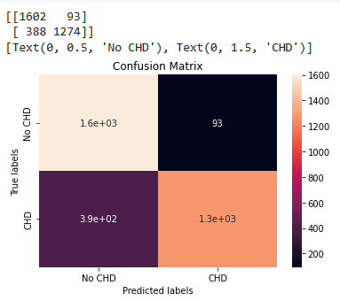
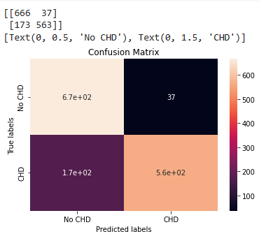
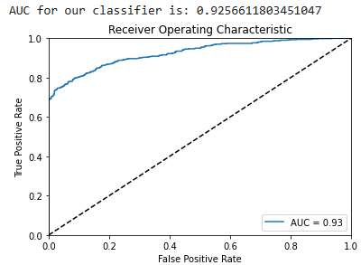
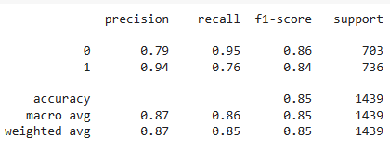
Model Validation
Logistic Regression
Training data
Testing data
AUC-ROC curve
Confusion Matrix
For class 1 [ patients at a risk of CHD ]
Recall = 0.76
Precision = 0.94
F1_score = 0.84
Test Accuracy = 0.86

Slide 25

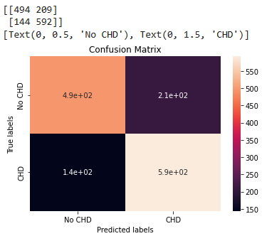
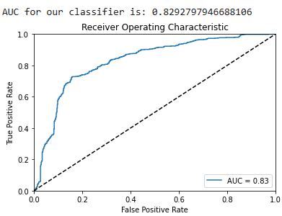
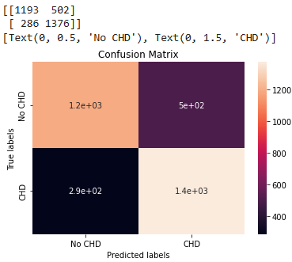
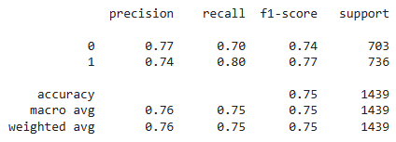
Model Validation
Naïve Bayes
Training data
Testing data
AUC-ROC curve
Confusion Matrix
For class 1 [ patients at a risk of CHD ]
Recall = 0.80
Precision = 0.74
F1_score = 0.77
Test Accuracy = 0.76

Slide 26

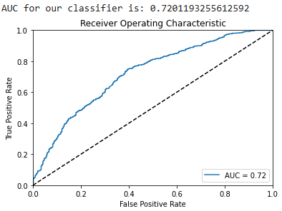
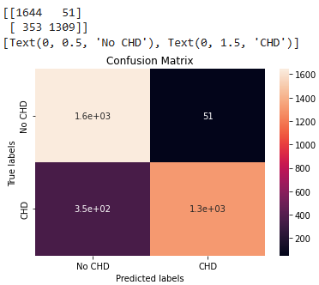
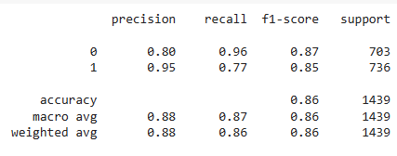
Model Validation
Support Vector Machines
Training data
Testing data
AUC-ROC curve
Confusion Matrix
For class 1 [ patients at a risk of CHD ]
Recall = 0.77
Precision = 0.95
F1_score = 0.85
Test Accuracy = 0.86

Slide 27

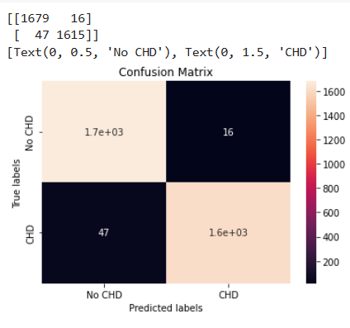
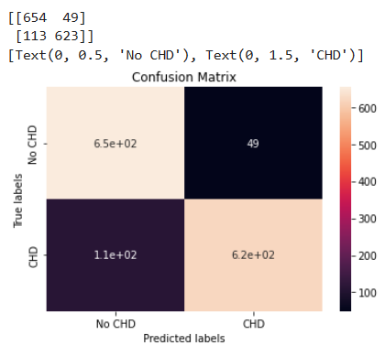
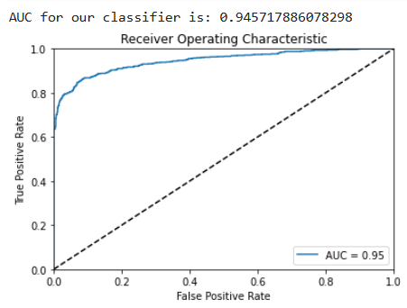
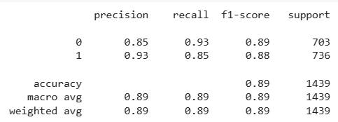
Model Validation
Random Forest
Training data
Testing data
AUC-ROC curve
Confusion Matrix
For class 1 [ patients at a risk of CHD ]
Recall = 0.85
Precision = 0.93
F1_score = 0.88
Test Accuracy = 0.89

Slide 28

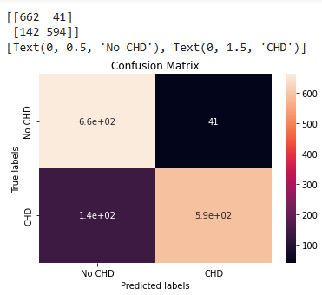
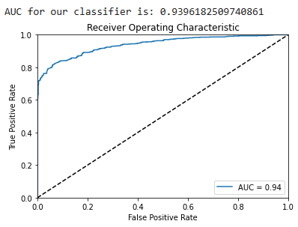


Model Validation
Extreme Gradient Boosting [ XG-Boost]
Training data
AUC-ROC curve
Testing data
Confusion Matrix
For class 1 [ patients at a risk of CHD ]
Recall = 0.81
Precision = 0.94
F1_score = 0.87
Test Accuracy = 0.86

Slide 29






Model Validation
K-Nearest Neighbors
Training data
AUC-ROC curve
Testing data
Confusion Matrix
For class 1 [ patients at a risk of CHD ]
Recall = 0.91
Precision = 0.84
F1_score = 0.87
Test Accuracy = 0.83

Slide 30

Feature Importance
Important features to be considered when diagonising a new patient
Age is the most important factor , when diagonising a patient related to CHD , followed by heart Rate & Blood Pressure. Hence, more focus be given on these factors

Slide 31

Model Comparison Summary
Logistic regression did produce a considerable result , but sufferred from the problem of underfitting.
Naïve-Bayes performed poorly initially , but the performance improved after cross-validation and hyperparameter tuning with var_smoothing value of 0.0001.
Same was the case with Support Vector Machines (SVM) , but after cross-validation and hyperparameter tuning , it’s performance increased significantly by using parameter value of C=1000, gamma =0.001 and ‘rbf’ kernel.
KNN performed significantly with following parameters:
XG-Boost gave good predictions without the need for tuning .
Random-forest produced the best result of all and classified the data precisely.

Slide 32
Conclusion
To provide immediate treatment to the patients at a risk of CHD . Type II error should be low ,
i.e High Recall value
To avoid time consumption on treating patients , with CHD diagnosis when actually they don’t have any. Type I error should be low, i.e High Precision is desired.
To treat patients with actual risk of CHD , there should be a balance between precision & recall.
i.e High F1-score is desirable ,since it punishes the extreme values more.
The models which provide the above desired results are as follows:
Recall – knn
Precision – SVM
F1-score – Random Forest
Test_accuracy – Random Forest
Age ,heart rate & Blood Pressure are the 3 most imortant features , for classifying the patients with a potential risk of CHD or not.
More focus should be given to the above features for the patients attending for treatment.

